Slide 1
Olist Inventory Analysis Presentation
BY
Suman Kumar Gouda
Vibha Kashyap
Vyshnavi Yerra

Slide 2

Project analysis slide 2
Agenda
BACKGROUND
SUMMARY
Olist
VISUALISATION
RECOMMENDATION
FINDINGS

Slide 3

Project analysis slide 8
Project Background
OLIST, an e-commerce company, has recently faced losses and wanted to eliminate unnecessary cost associated with inventory management.
The agenda is to identify the top product categories which are generating high revenue and come up with a plan for better management of inventory and to avoid any extra cost..

Slide 4
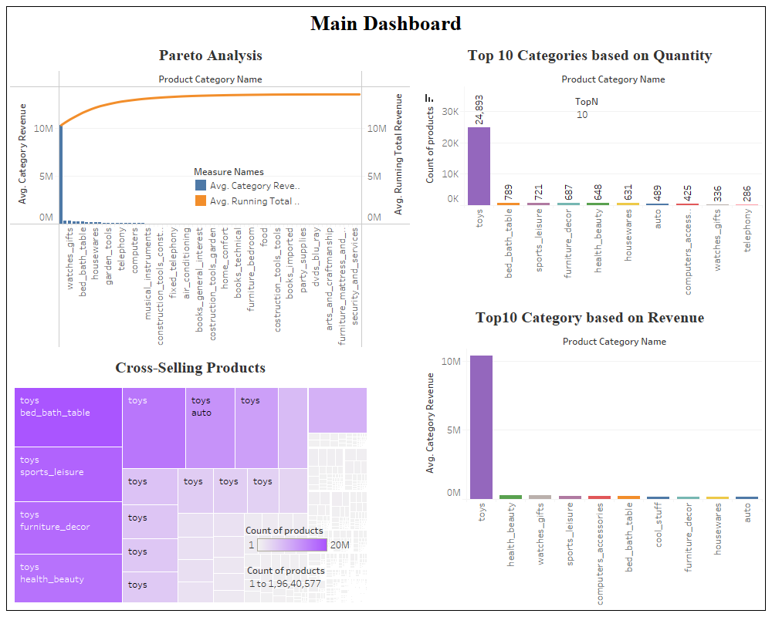
Project analysis slide 10
Project Analysis

Slide 5
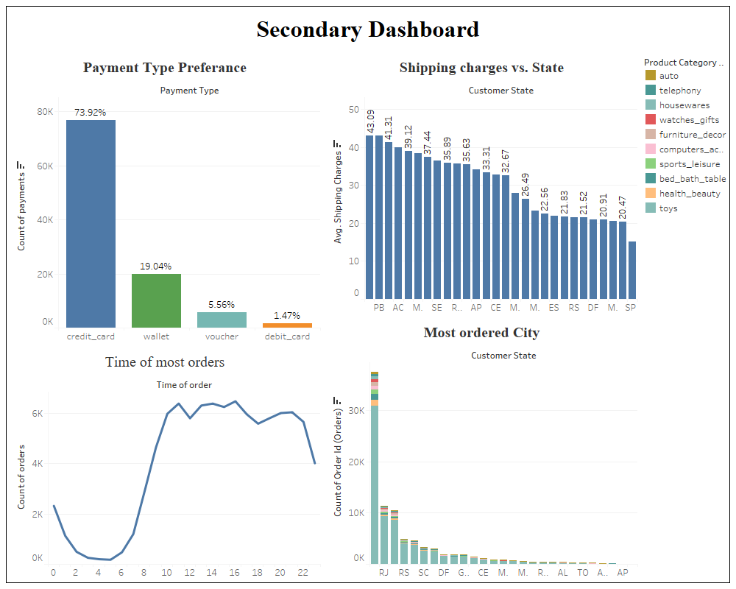
Project analysis slide 11
Editing Data
Slides

Slide 6
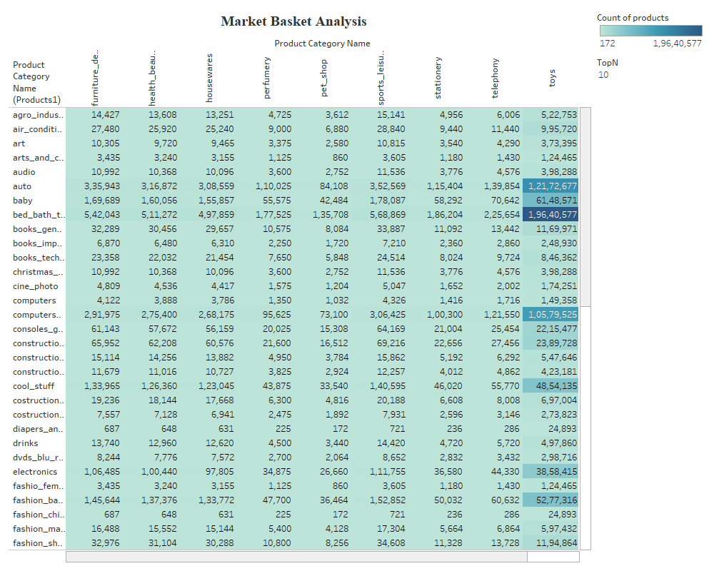
Project analysis slide 11
Editing Data
Slides

Slide 7
Project analysis slide 3
Findings
Toys alone contribute to about 76% of total revenue.
Bed bath table, sports leisure, furniture decor, health beauty are products that can be promoted for cross-selling with toys.
.
Products from categories like toys, bed bath table, sports leisure, furniture décor, health beauty are contributing 80% of the sales and revenue.
Toys is the highest selling product category.

Slide 8
Project analysis slide 6
Recommendation
As our most of the customers using credit card so we need to use more credit card option and offers to attract new customers as well as retain the old customers
Company should always maintain a stock of toys, bed bath table, sports leisure, furniture décor, health beauty.
We can give discounts and a referral coupon to our top 10 customers so that we can get some new customers and get word of mouth publicity.
.
Category like home appliances ,construction tools, luggage accessories , musical instruments etc. that are not having subsequent contribution to the revenue and sales can be shed as currently company is facing losses.
To get rid of already existing heavy stock of slow moving products. Company can put them on sale and start reframing its future strategy referred to inventory control..
Between the times of 11am to 4pm most of the customers stay active so we can run advertise about our products and offers so will get maximum reach.
The state SP has most no. of orders, so we create a small warehouse nearby to reduce the shipping cost
.

Slide 9
Project analysis slide 4
Summary
Product &
Product categories
Raw data
In excel
.
Data cleaning
Using
python
Data visualization using tableau
Insights.
Customer
behavior
Project Objectives
Implementation Plan
Customer Objectives
Market Basket
analyses

Slide 10
Thank You

